Slide 1
NoSQL and the evolution of databases
MongoDB & GIS
Simon Oulevay
simon.oulevay@heig-vd.ch
2016, Comem+
Inspired by the "GIS with NoSQL" workshop at the Helsinki 2016 AGILE conference:
https://www.unibw.de/inf4/professors/geoinformatics/agile-2016-workshop-gis-with-nosql
By Wolfgang Reinhardt, Eszter Gálicz & Stephan Schmid

Slide 2
“NoSQL market expected to reach $4.2 Billion globally by 2020”
“Graph based NoSQL market poised to grow at a rapid CAGR of 40.8%, during 2014-2020”
-- GISuser, April 2015, citing Allied Market Research report

Slide 3
What is NoSQL?

Slide 4
Structural Variety in Big Data
Historically, SQL favored:
Business data = money
In-house operation
Tabular & relational data: customers, stock items, transactions, etc.
However, there's more data (and Big Data):
Stock trading: 1D sequences, i.e. arrays
Social networks: large, homogeneous graphs
Ontologies: small, heterogeneous graphs
Climate modelling: 4D/5D arrays
Satellite imagery: 2D/3D arrays
Genome: long string arrays
Particle physics: sets of events
Bio taxonomies: hierarchies (e.g. XML)
Documents: key/value stores

Slide 5
What is NoSQL?
Modern web-scale databases
non-relational
distributed
open-source
horizontally scalable
schema-free
easy replication support
simple API
eventually consistent / BASE (not ACID)
a huge amount of data
structural variety
http://nosql-database.org
NoSQL databases are next-generation databases addressing some of these points.
And often some of these points as well.

Slide 6
NoSQL is Fast
On >50GB of data:
MySQL:
Writes: 300ms avg
Reads: 350ms avg
Cassandra:
Writes: 0.12ms avg
Reads: 15ms avg

Slide 7
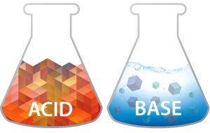
vs.
Atomicity
Consistency
Isolation
Durability
Basically Available
Soft state
Eventually consistent
Characteristics:
ACID
Strong promises, desirable for many domains (e.g. banks)
Computationally expensive, in particular when distributed
Characteristics:
Service availability first
Approximate answers OK (write not guaranteed)
No transactions
Weak consistency (stale data OK)
Simpler & faster

Slide 8
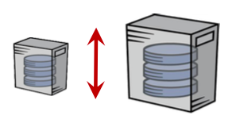
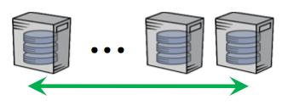
Scalability
Vertical scaling
performance on single server
Horizontal scaling
over multiple servers
RAM, avoid random disk I/O
Minimize overhead for locking & latching
Minimize network calls between servers
Partition
Replicate
Automatic failure recovery
Zero downtime

Slide 10
Key/Value Stores
Essentially a (distributed) hash table
Fast, direct access to (often smallish) data values
Operations:
Put(key, value)
value = Get(key)
More operations for some (e.g. Redis)
MemCacheDB
Riak
MemCache
Cassandra
Redis
Voldemort
SimpleDB

Slide 11
Document-oriented Databases
Like key/value stores, but the value is a (often large) document
Semi-structured data
Searchable (e.g. full text search)
Useful for content-oriented applications (e.g. Facebook, Amazon)
MongoDB
ElasticSearch
CouchDB

Slide 12
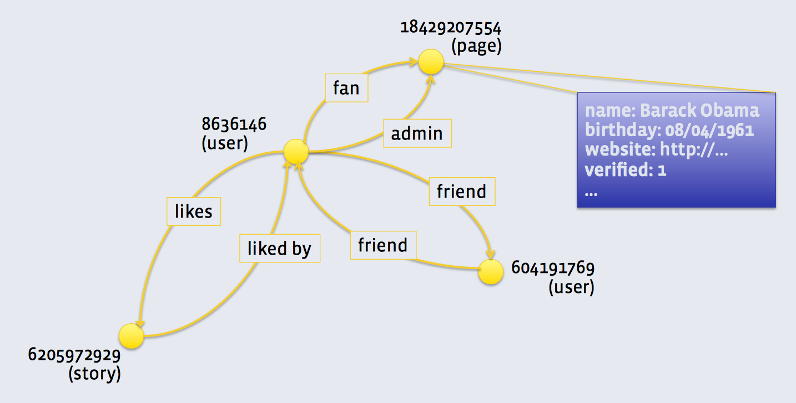
Graph Databases
Conceptual model: attributed graph
Application: ontologies, social networks, Internet of Things, geometric modeling
RDF/SPARQL
Facebook TAO
Neo4j

Slide 13
Array Databases
Conceptual model: n-D arrays
Application: satellite imagery & signal processing
rasdaman
DaggerDB

Slide 14
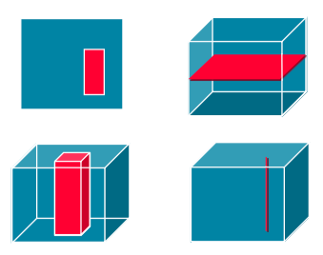
Geospatial Processing
OGC Web Coverage Service (WCS)
Digital geospatial information representing space/time-varying phenomena
Formatting on-the-fly (e.g. trim, slice)
OGC Web Coverage Processing Service (WCPS)
Spatio-temporal datacube analytics language
Time series analysis, Image processing, sensor fusion, pattern mining
rasdaman
GDAL
QGIS
OpenLayers
Pyxis
ArcGIS
OPeNDAP
MapServer
GeoServer

Slide 15
NewSQL

Slide 16
NewSQL
Goal: same scalable performance as NoSQL for common read-write workloads while maintaining ACID guarantees of traditional DBMSs.
How?
Column stores
Main memory DB
New datatypes & functionality in SQL

Slide 17
Column Stores
Relational DBMS with:
Columnar storage architecture
Compression & novel processing
Faster than row-based stores? Only if you don't often need to retrieve entire rows. So it depends on your workload.
Not a new idea (TAXIR, 1969; KDB, 1993)
Sysbase IQ
KDB
MonetDB
HBase
Vertica
Druid
ID | Product | Customer | Date | Sale
1 | Beer | Thomas | 2011-11-25 | 2 GBP
2 | Beer | Thomas | 2011-11-25 | 2 GBP
3 | Vodka | Thomas | 2011-11-25 | 10 GBP
4 | Whiskey | Christian | 2011-11-25 | 5 GBP
5 | Whiskey | Christian | 2011-11-26 | 5 GBP
6 | Vodka | Alexei | 2011-11-26 | 10 GBP
7 | Vodka | Alexei | 2011-11-26 | 10 GBP
row
based
PRODUCT
Value | Row IDs
Beer | 1, 2
Vodka | 3, 6, 7
Whiskey | 4, 5
CUSTOMER
Value | Row IDs
Thomas | 1, 2, 3
Christian | 4, 5
Alexei | 6, 7
DATE
Value | Row IDs
2011-11-25 | 1, 2, 3, 4
2011-11-26 | 5, 6, 7
SALE
Value | Row IDs
2 GBP | 1, 2
10 GBP | 3, 6, 7
5 GBP | 4, 5
column
based

Slide 18
Main Memory DB
RAM is faster than disk
Load the DB into RAM
Doable now with lower hardware price
Oracle ships 1PB RAM servers
Vertical scaling, not horizontal
Oracle TimesTen
HyPer
Microsoft Hekaton
VoltDB
Calvin
IBM solidDB

Slide 19
New SQL Superpowers
Array, map & JSON columns in PostgreSQL
Additional analytics: trigonometric and logarithm functions
Multi-dimensional arrays (SQL/MDA)
Row pattern recognition
Polymorphic table functions

Slide 20
(No)SQL Final Thoughts

Slide 21
Misconceptions
NoSQL is new
dbm (1979), Internet's Domain Name System (1982), Berkeley DB (1991). The name "NoSQL" dates from 1998.
NoSQL is schema-free, so it eases migrations
No standards, vendor lock-in (DBMS migration). Data structure still evolves (DB migration).
No joins & no query language = simpler & more performance
Less flexibility & power at the database level = more application burden, more data transport.
NoSQL is fast
Yes but generally at the price of weak consistency. Also, setting up horizontal scalability is a considerable overhead.
Relational databases are dead
NoSQL databases mark the end of the era of relational databases, but they will not become the new dominators. Relational will still be popular, and used in many situations, but it will no longer be the automatic choice.

Slide 22
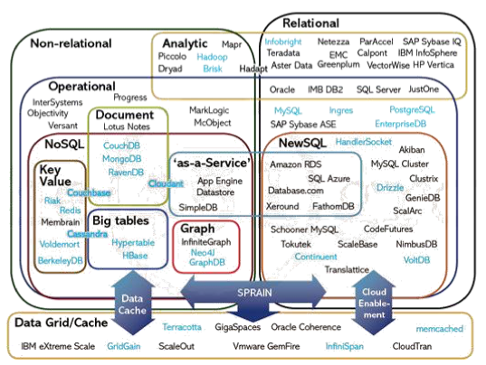
NoSQL is a lot of things

Slide 23
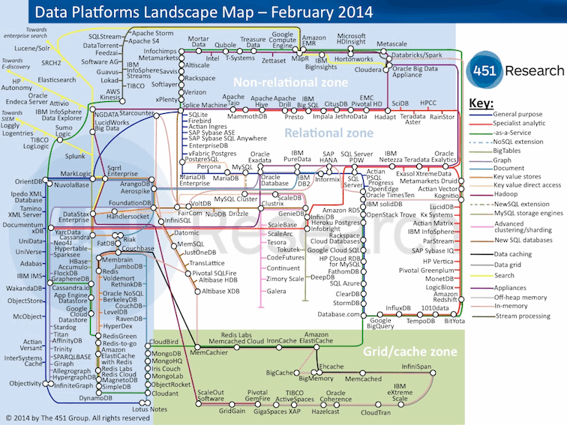
And more...

Slide 25
GIS & Databases
GIS = database + visual interface
"Without a way to store, retrieve and analyze data, you have nothing more than a static map."
GIS today deals with large and complex data (a.k.a. Big Data), and needs specialized data management

Slide 26
GIS & NoSQL
A partial survey of NoSQL stores with geo support
Name | Index strategy | Data types | Query types
Amazon DynamoDB | geohash | point | bbox, radius
GeoCouch | R-tree | point, line, poly | bbox, radius
IBM Cloudant (CouchDB) | R*-tree | GeoJSON types | bbox, radius, arbitrary shape
Lucene/Solr | geohash | point | bbox, radius
Orchestrate.io | geohash | point | bbox, radius
Microsoft DocumentDB | - | - | -
MongoDB | geohash/quadtree | GeoJSON types | bbox, radius, arbitrary shape

Slide 28
MongoDB: JSON documents
It's a document-oriented database
It stores JSON data (actually BSON)
JSON documents (analogous to rows) are stored in collections (analogous to tables).

Slide 29
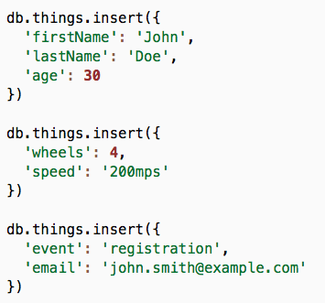
MongoDB: schema-less
It's a schema-less database
You can insert anything into a collection, even if the objects have a completely different structure (not necessarily a good idea)
The database is created on-the-fly when you connect to it (if doesn't yet exist); commands are queued until the database is ready
Collections (like things) are also created on-the-fly when you first access them
Basically Available (BASE)

Slide 30
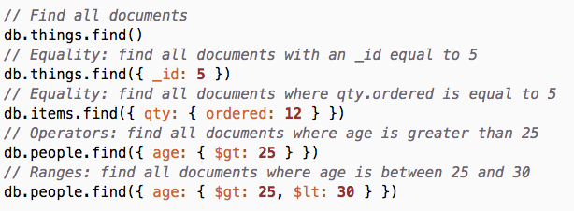
MongoDB: find
db.collection.find(query)
MongoDB's find is like SQL's SELECT
Queries are also JSON objects
https://docs.mongodb.com/v3.2/reference/method/db.collection.find/

Slide 31
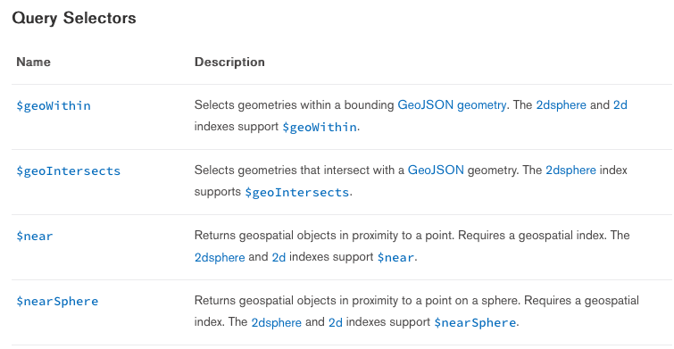
MongoDB: Geospatial
https://docs.mongodb.com/v3.2/reference/operator/query-geospatial/

Slide 32
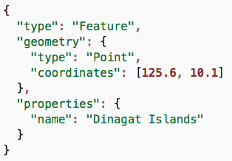
MongoDB: GeoJSON
GeoJSON is a format for encoding a variety of geographic data structures.
Available types: Point, LineString, Polygon, MultiPoint, MultiLineString, and MultiPolygon
http://geojson.org
http://geojson.org/geojson-spec.html

Slide 34
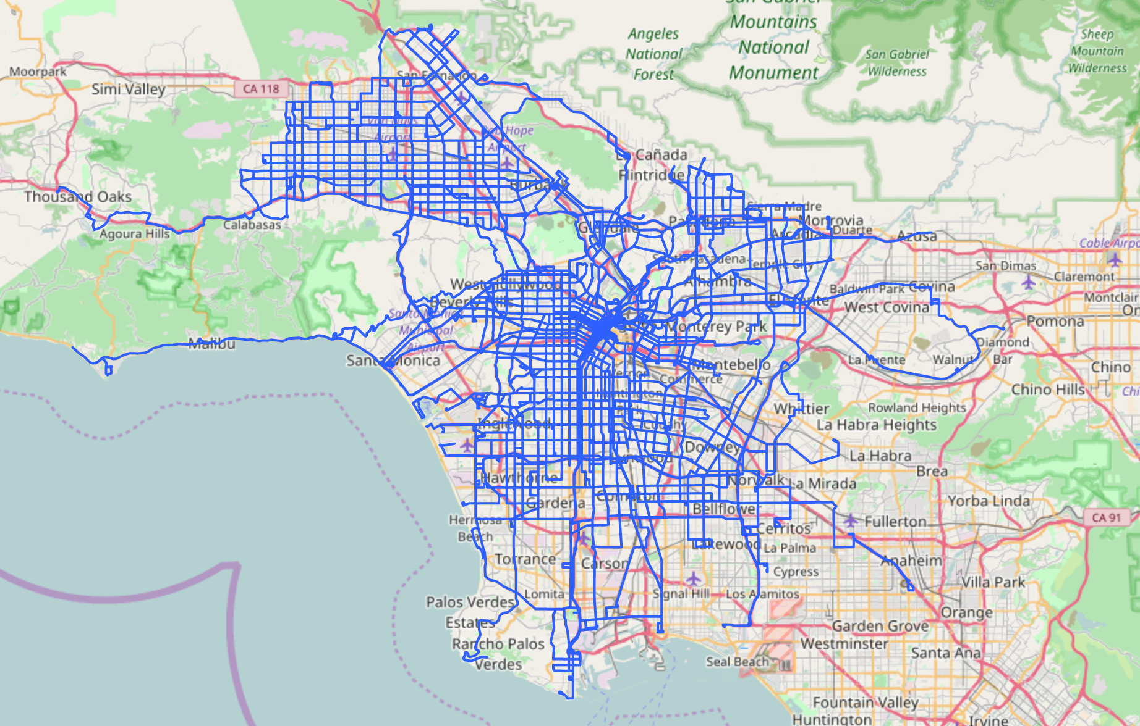
Data set
Los Angeles County Metropolitan Transportation Authority
https://github.com/jdorfman/awesome-json-datasets

Slide 35
Data set: format
The database contains one collection: features.
Each document in the collection is a GeoJSON feature:
The operator area is represented by one feature with a Polygon geometry.
Transportation routes are represented by multiple features with a MultiLineString geometry.
Train/bus stops are represented by multiple features with a Point geometry.

Slide 36



Exercise Web App

Slide 37
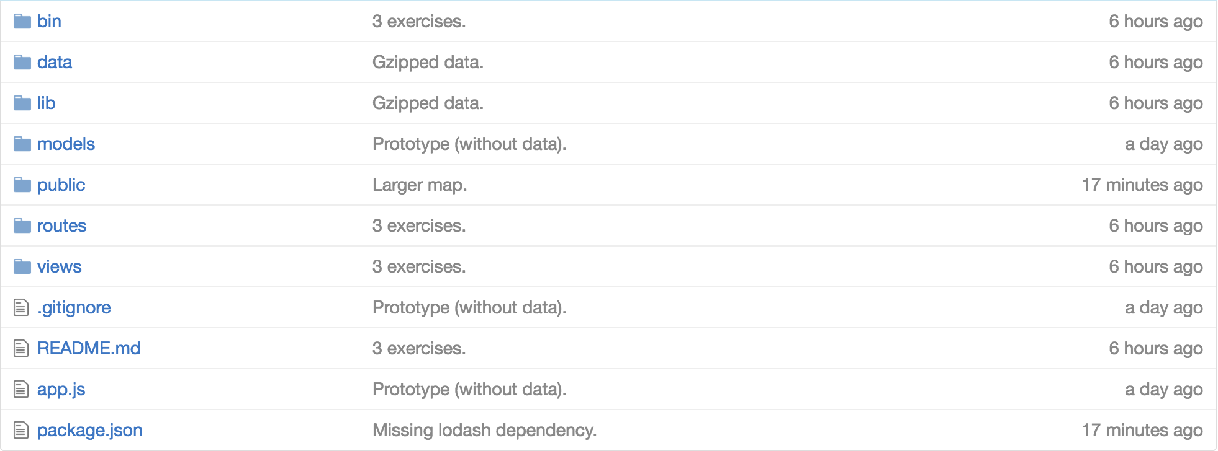

Exercise Web App
Server run script
JSON dataset
Server utilities
Angular app
Server routes
View templates
Express app
Server deps

Slide 38
http://stark-mountain-72407.herokuapp.com/
https://github.com/MediaComem/comem-geoinf-2016-mongodb-gis

